Slide 1
NYSE TAQ Data
NYSE Trade and Quote Data
TAQ data structure

Slide 2
Outline
Understanding Liquidity
“The Empirical Analysis of Liquidity”, Holden, Jacobsen, Subrahmanyam, Foundations and Trends in Finance
“Theories of Liquidity”, Vayanos, Wang, Foundations and Trends in Finance
How Liquidity is measured

Slide 3
Liquidity
What is a liquidity?
The ability to trade a significant quantity of a security at a low cost in a short time
Liquidity is a multi-dimensional concept
Quantity
Cost
Time
Modern theory of Market microstructure formulates the trading process as an interaction between liquidity suppliers and liquidity demanders
Liquidity suppliers : Offer to buy a particular security at a bid price or sell it at an offer price
Liquidity demanders : Agree to buy the security at the offer price or sell it at the bid price

Slide 5
Problems in measuring liquidity
It is unobservable most time
Need to find some variables which is a proxy for liquidity measurement
Data limitations
Abundant data in equity markets : various measures have been developed
Some specialized measures of liquidity need to be developed to deal with data limitations in specific markets (futures, bonds, and other non-exchange markets)
Depending on data availability, we need to infer some measures from daily level data
Liquidity is not an exogenous variable
Some changes in regulations affect the liquidity level (tick size changes, market reforms, and etc.)

Slide 6
Standard measures of liquidity
Cost dimension
Quoted spread, Effective spread, Realized spread, Price impact
The lower these measures are, the higher the liquidity is
Quantity dimension
Quoted depth, Slope of the limit order book, Slope of the price function
Time dimension
Execution speed, Partial fill rate, Complete fill rate, Cancellation rate, Resilience

Slide 7
Some concepts
High trading costs (commissions, fees, opportunity costs, bid-ask spreads, etc.) are linked to less liquid securities
Related concepts
Depth : the quantity available for sale or purchase away from the current market price
Breadth : the market has many participants
Resilience : Price impacts caused by the trading are small and quickly die out

Slide 8
Major questions about illiquidity
Q : Do assets with high spreads and or price impact have high average returns? (Cross-sectional)
A : Positive relationship between expected stock returns and alternative proxies for individual illiquidity levels
Q: Are there any properties in time series of the aggregate liquidity measures? (Time-series)
A : Existence of predictability and commonality in liquidity
Q : Are the systematic component of liquidity as a source of priced risk?
A: liquidity risk is a priced source of risk when the model is fitted to US equity data
Pastor and Stambaugh(2003) reports a 7.5% annual premium
Acharya and Pederson (2002) reports a 1.1% annual premium

Slide 9
The Cost Dimension
Quoted Spread : (A- B) /2
Relative Quoted Spread : (A – B)/(A + B) = 2 (A- B)/ M
Effective Spread : 2|P – M|
Relative Effective Spread : 2 |P – M|/M
Realized Spread : 2 |P – M’|
Effective Spread = Price Impact + Realized Spread
Price Impact = M’ – M
A : Ask price , B : Bid Price , M = Mid point = (A + B)/2
M’ = Mid Point after some time period

Slide 12
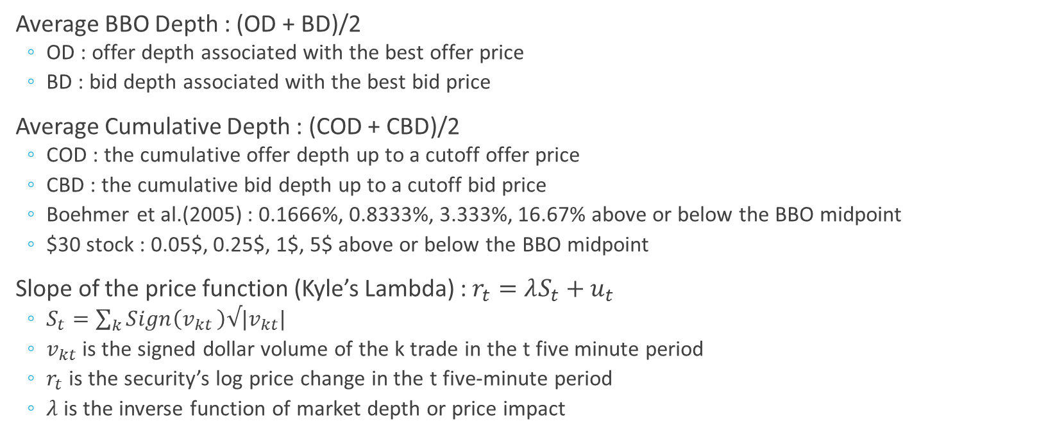
Quantity Dimension
Average BBO Depth : (OD + BD)/2
OD : offer depth associated with the best offer price
BD : bid depth associated with the best bid price
Average Cumulative Depth : (COD + CBD)/2
COD : the cumulative offer depth up to a cutoff offer price
CBD : the cumulative bid depth up to a cutoff bid price
Boehmer et al.(2005) : 0.1666%, 0.8333%, 3.333%, 16.67% above or below the BBO midpoint
$30 stock : 0.05$, 0.25$, 1$, 5$ above or below the BBO midpoint
Slope of the price function (Kyle’s Lambda) : $r_{t}=λS_{t}+u_{t}$
$S_{t}=\sum_{k}{Sign\left(v_{kt }\right)√|v_{kt}|}$
$v_{kt}$ is the signed dollar volume of the k trade in the t five minute period
$r_{t}$ is the security’s log price change in the t five-minute period
$λ$ is the inverse function of market depth or price impact

Slide 13
Time Dimension
Speed of partial execution : pt – st
pt: the earliest moment that the order partially or completely executes
st: the submission time of the order
Speed of complete execution : ct – st
ct: the final moment at which the order completes executing
Speed of Cancellation : cant – st
cant: the moment at which the order is cancelled
Partial fill rate : np/ns
np: the number of orders that partially or completley execute
ns: the number of orders submitted
Complete fill rate : nc / ns
nc: the number of orders that completely execute
Cancellation rate : ncan/ns
ncan: the number of orders that are cancelled

Slide 14
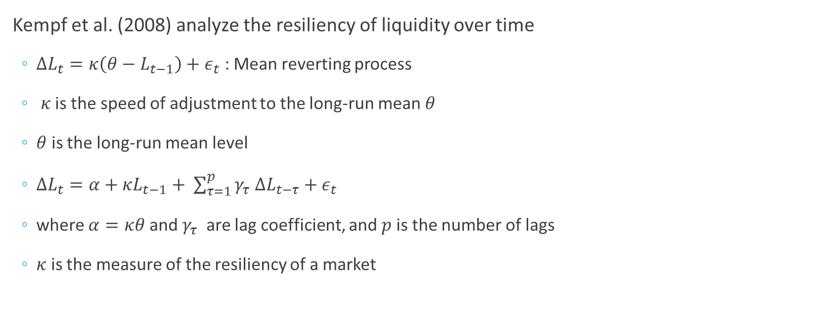
Time dimension (estimation)
Kempf et al. (2008) analyze the resiliency of liquidity over time
$ΔL_{t}=κ\left(θ−L_{t−1}\right)+ε_{t}$ : Mean reverting process
$κ$ is the speed of adjustment to the long-run mean $θ$
$θ$ is the long-run mean level
$ΔL_{t}=α+κL_{t−1}+ \sum_{τ=1}^{p}{γ_{τ} ΔL_{t−τ}+ε_{t}}$
where $α=κθ$ and $γ_{τ}$ are lag coefficient, and $p$ is the number of lags
$κ$ is the measure of the resiliency of a market

Slide 15
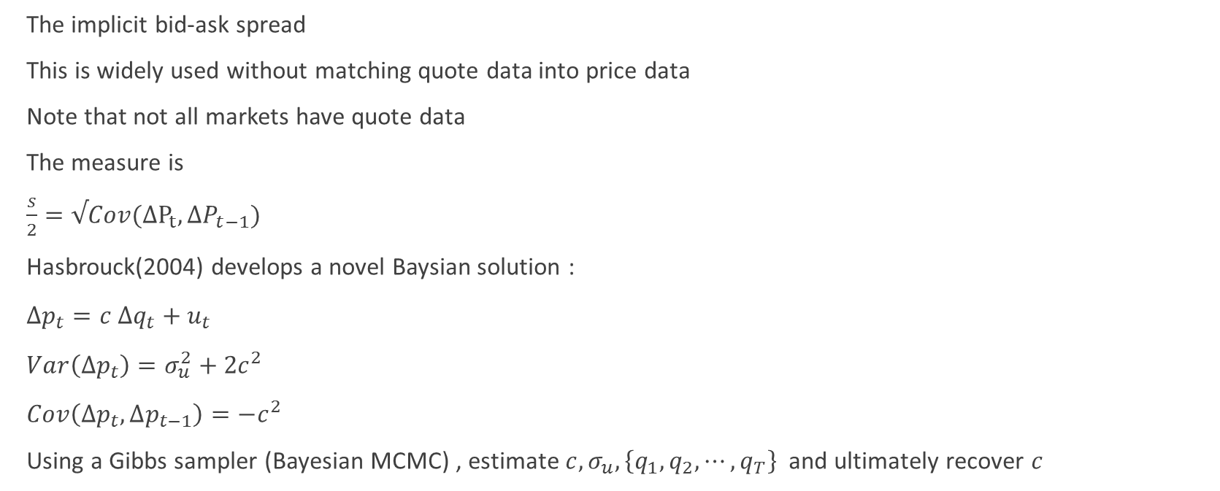
Roll(1984)’s spread
The implicit bid-ask spread
This is widely used without matching quote data into price data
Note that not all markets have quote data
The measure is
$\frac{s}{2}=√Cov(ΔP_{t}, ΔP_{t−1})$
Hasbrouck(2004) develops a novel Baysian solution :
$Δp_{t}=c Δq_{t}+u_{t}$
$Var\left(Δp_{t}\right)=σ_{u}^{2}+{2c}^{2}$
$Cov\left(Δp_{t},Δp_{t−1}\right)=−c^{2}$
Using a Gibbs sampler (Bayesian MCMC) , estimate $c, σ_{u}, \left\{q_{1},q_{2},⋯, q_{T}\right\}$ and ultimately recover $c$

Slide 16
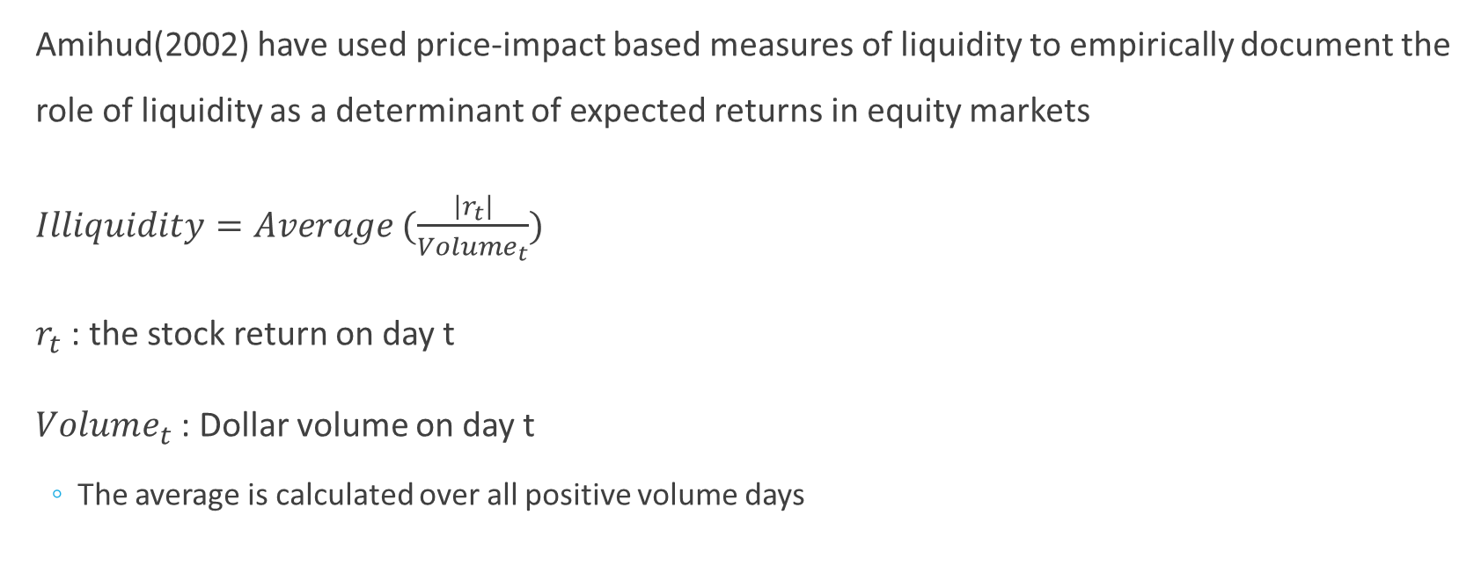
Amihud(2002) measure
Amihud(2002) have used price-impact based measures of liquidity to empirically document the role of liquidity as a determinant of expected returns in equity markets
$Illiquidity=Average (\frac{\left|r_{t}\right|}{Volume_{t}})$
$r_{t}$ : the stock return on day t
$Volume_{t}$ : Dollar volume on day t
The average is calculated over all positive volume days

Slide 17
Implementation Shortfall
IS : The difference between the decision price and the final execution price (including commissions, taxes, etc.) for a trade. This is also known as the “slippage”
Prop traders are mainly concerned with minimizing implementation shortfall and finding liquidity
The decision price is the price of the stock that prompted the decision to buy or sell.
The close price or the arrival price
Brokerage firms specialized in developing algorithmic strategies, and providing them to the institutional investment company, that help to minimize slippage from benchmarks such as implementation shortfall, VWAP, or TWAP.

Slide 18
Benchmarks
The industry uses several alternative benchmarks
Volume-Weighted-Average-Price (VWAP) of all trades over the period when the order was being filled(Abel/Noser)
Closing Prices (SEI)
Implementation Shortfall (Plexus Group)
Calculate the value of a paper-portfolio based on having bought (or sold) shares at the prevailing prices when the decision was made
Usually, the benchmark price used is the mid-quote at the time the decision was made
Compare the value of the paper portfolio to the actual value of the portfolio after all orders have been filled (transaction costs)
Multiply the unfilled sized by the difference between the current price and the benchmark price (missed trade opportunity cost)
Average of the daily opening, high, low, and closing prices (Elkins/McSherry)

Slide 23
Trading costs for institutional-size orders

